Slide 1
Qiskit Structure and Circuit Building
Connecting Python Environments with IBM Quantum

Slide 2
What is Qiskit
Open-source SDK for quantum computing
Developed by IBM
Used to build, simulate, and run quantum circuits
Written in Python

Slide 3
Qiskit Structure Overview
Terra: Foundation layer for circuits and optimization
Aer: Simulation layer for local testing
IBM Quantum Provider: Interface to real quantum devices

Slide 4
Qiskit Terra
Handles circuit construction and transformations
Includes:
QuantumCircuit
Transpiler
PassManager

Slide 5
Qiskit Aer
Simulates quantum circuits locally
Useful for debugging and testing
Backends:
qasm_simulator
Statevector_simulator

Slide 6
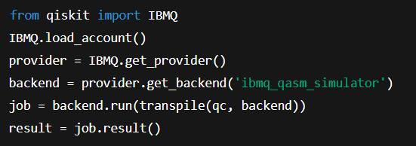
IBM Quantum Provider
Connects to real IBM Quantum devices
Uses IBM Quantum account

Slide 7
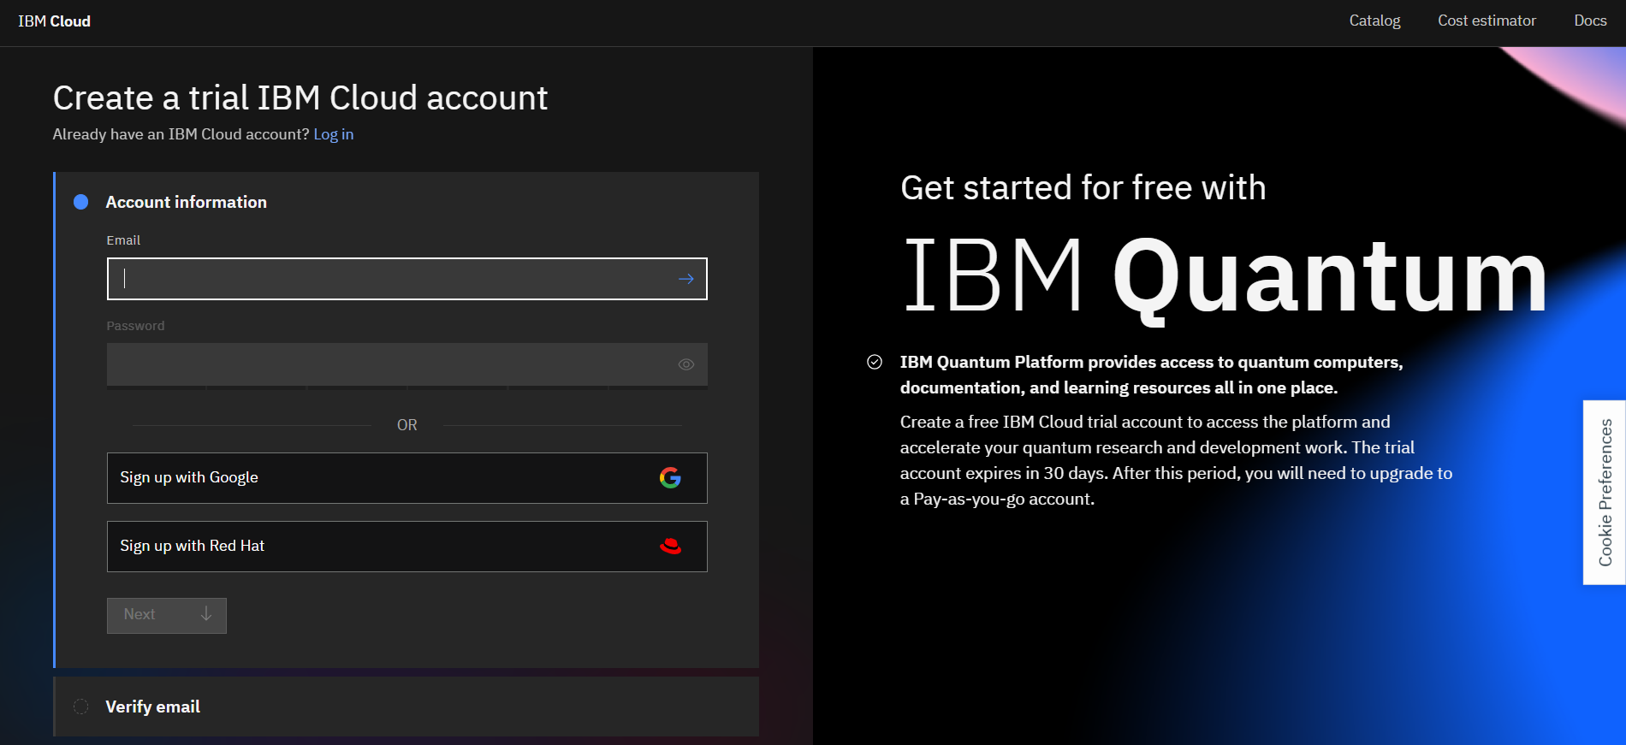
Connecting Jupyter with IBM Quantum
Create IBM Cloud account

Slide 8
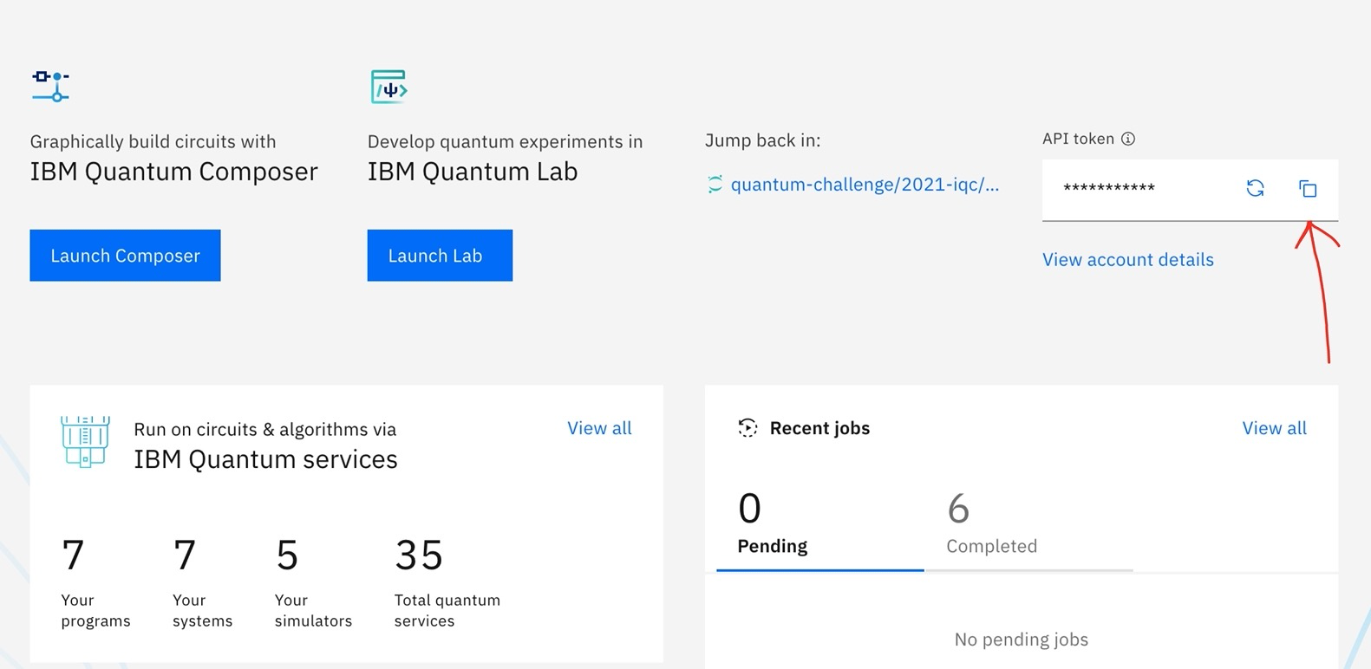
Step 2: Get the API key

Slide 9

use the api key

Slide 10

Connecting Google Colab with IBM Quantum
Steps:
Install Qiskit in Colab
!pip install qiskit
Import and save your token
Load provider and access devices
example

Slide 11
Summary
Terra handles logic and circuits
Aer simulates circuits
IBM Quantum Provider connects to hardware
Jupyter and Colab are both supported environments

